Slide 1
Photomicrographs of Plant foods
Bean: Green
Permission to reproduce original photomicrographs used to make this collection may be obtained from
Dr. David O. Norris at
david.norris@colorado.edu

Slide 2
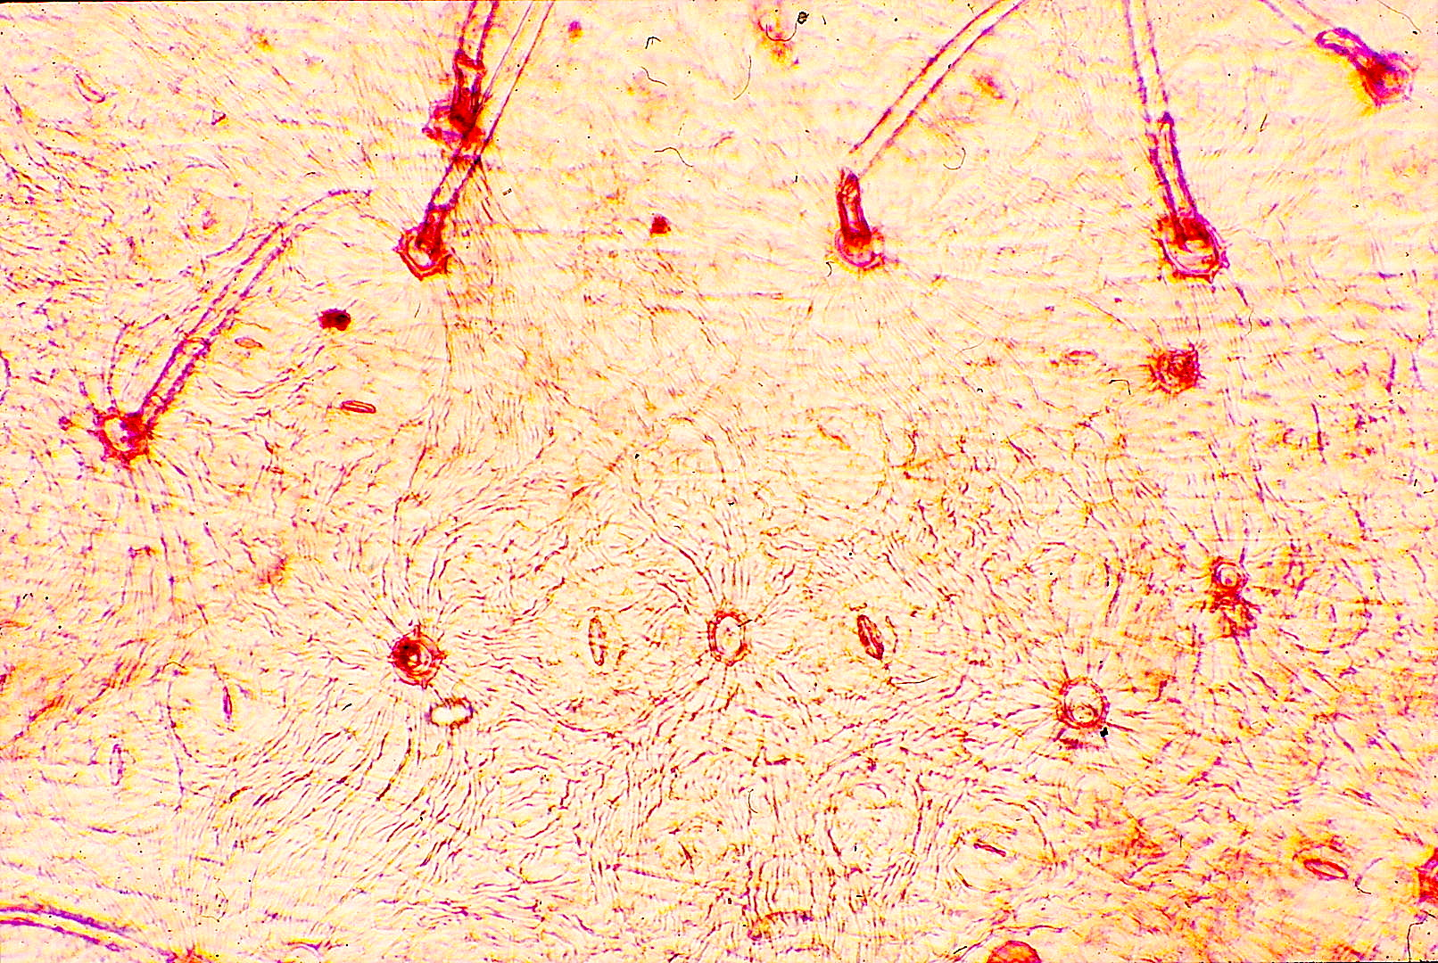
Notes:
51. Phaseolus vulgaris L. Bean, green, pod surface with trichomes (arrows)

Slide 3
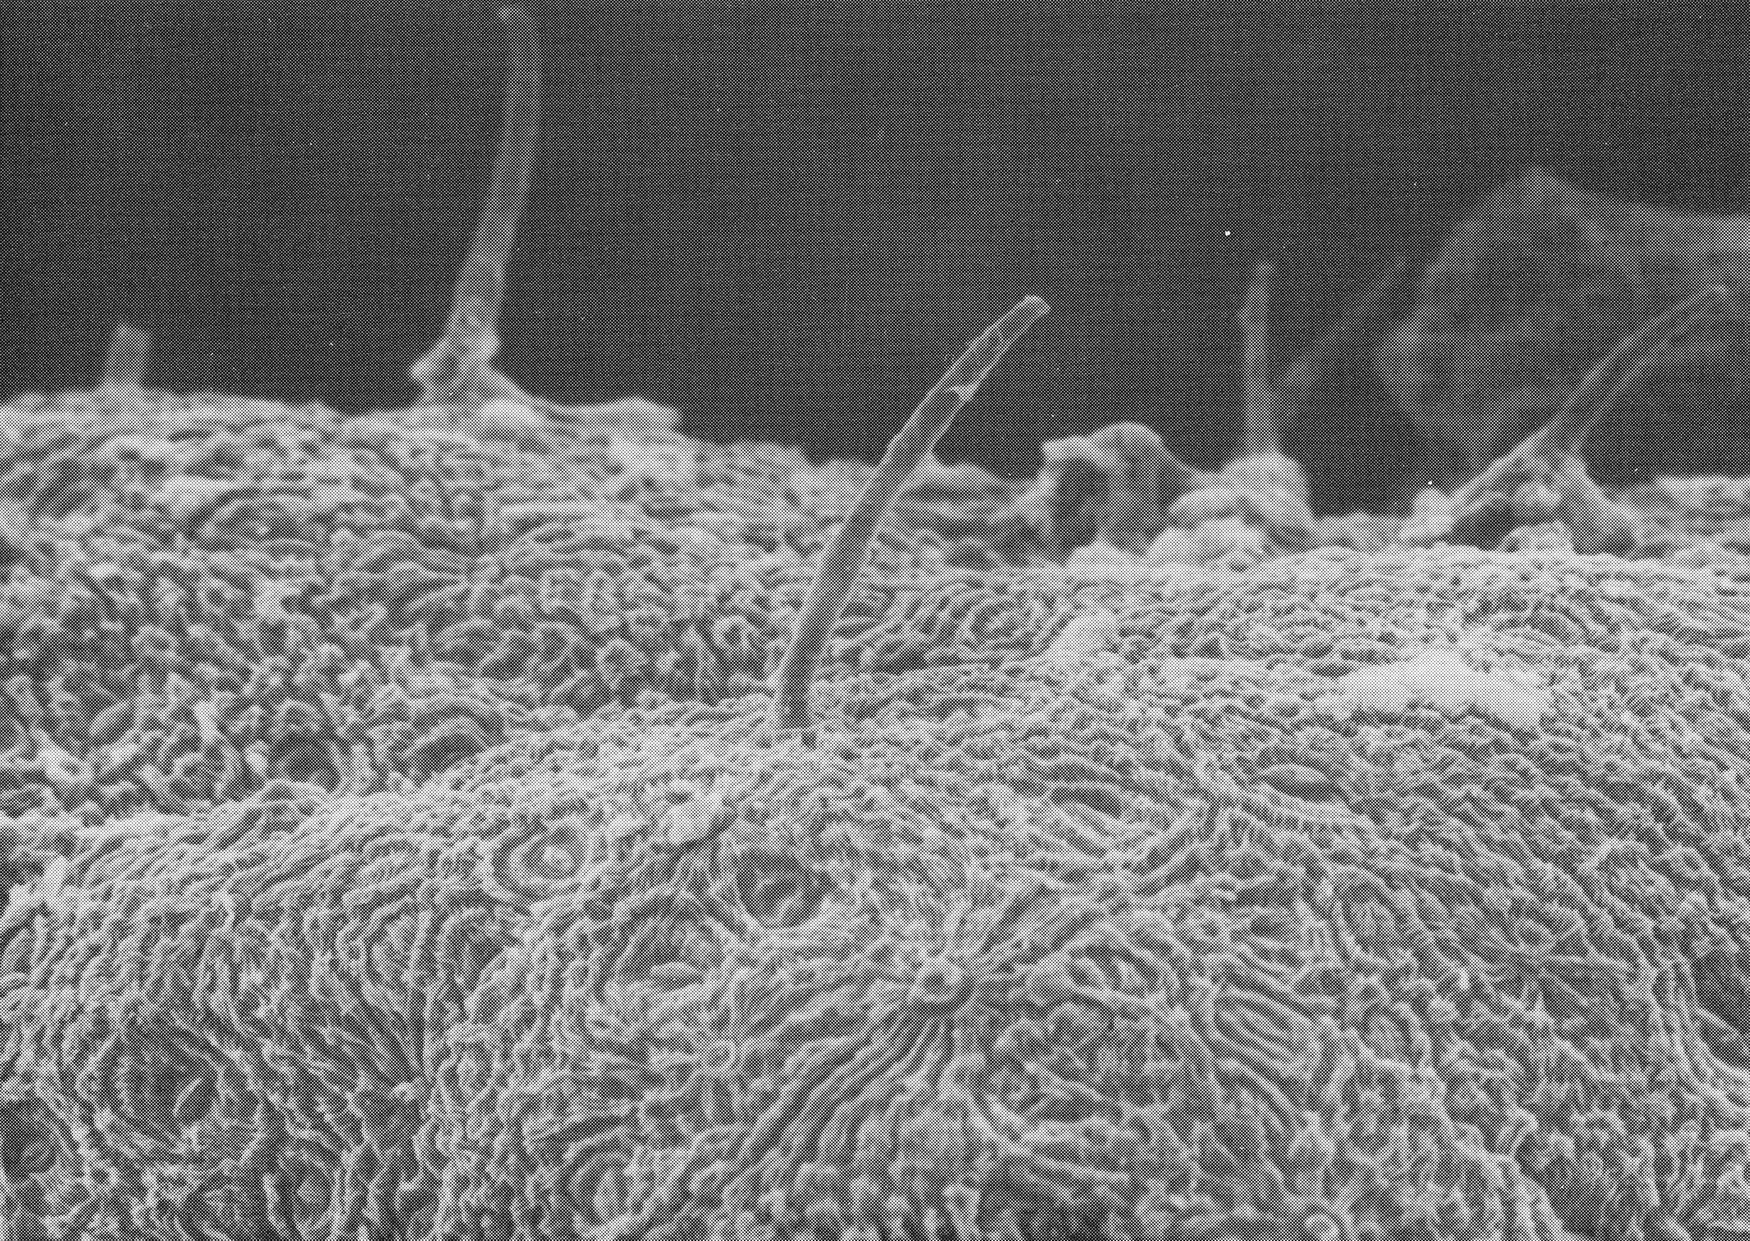
100µm
Notes:
52. Bean, green. SEM of surface showing trichomes (arrows). Courtesy of Dr. Meredith A. Lane.

